Slide 1


Movie recommendation system
A Minor Project Synopsis Submitted to
Rajiv Gandhi Proudyogiki Vishwavidyalaya, Bhopal
Towards Partial Fulfillment for the Award of
Bachelor of Technology (Computer Science and Engineering)
Under the Supervision of Prof. Preeti shukla
Submitted By
Deepak Patidar (0827CS201063)
Department of Computer Science and Engineering Acropolis Institute of Technology & Research, Indore Jan-June 2023

Slide 2
Synopsis
Abstract
The recommendation system plays an essential role in the modern era and used by many prestigious applications. Movie recommendation systems aim at helping movie enthusiasts by suggesting what movie to watch without having to go through the long process of choosing from a large set of movies which go up to thousands and millions that is time consuming and confusing. In this article, our aim is to reduce the human effort by suggesting movies based on the user’s interests. To handle such problems, we introduced a model combining both content-based and collaborative approach. It will give progressively explicit outcomes compared to different systems that are based on content-based approach. Content-based recommendation systems are constrained to people, these systems don’t prescribe things out of the box, thus limiting your choice to explore more. Hence, we have focused on a system that resolves these issues.
Keywords: Movie recommendation, Rating, Genre, Recommender system, Collaborative filtering.
Introduction of the Project.
A recommendation system or recommendation engine is a model used for information filtering where it tries to predict the preferences of a user and provide suggests based on these preferences. These systems have become increasingly popular nowadays and are widely used today in areas such as movies, music, books, videos, clothing, restaurants, food, places and other utilities.
A large number of companies are making use of recommendation systems to increase user interaction and enrich a user's shopping experience.
Recommendation systems have several benefits, the most important being customer satisfaction and revenue. Movie Recommendation system is very powerful and important system. But, due to the problems associated with pure collaborative approach, movie recommendation systems also suffers with poor recommendation quality and scalability issues.
Objectives :
Improving the Accuracy of the recommendation system.
Improve the Quality of the movie Recommendation system.
Improving the Scalability.
Enhancing the user experience.

Slide 3
Synopsis
Provide the reviews of the public on movie whether it is good or bad.
Provide information about the cast and directors of the movie.
Methodology:
The movies are recommended based on the content of the movie you entered or selected. The main parameters that are considered for the recommendations are the genre, director, and top 3 casts. The details of the movies, such as title, genre, runtime, rating, poster, casts, etc., are fetched from TMDB. The reviews of each individual movie given by the users are "web-scraped" from the IMDB website with the help of beautifulsoup4, and the reviews are subjected to sentiment analysis, where the model predicts whether the review is positive or negative.
Collecting the data sets: Collecting all the required data set from Kaggle
Data Analysis: make sure that that the collected data sets are correct and analysing the data in the csv files. i.e. checking whether all the column Felds are present in the data sets.
Algorithms: in our project we have only two algorithms one is cosine
similarity and other is single valued decomposition are used to build the machine learning recommendation model.
Training and Testing the model: once the implementation of algorithm is completed . we have to train the model to get the result. We have tested it several times the model is recommend different set of movies to different users.
Improvements in the project: In the later stage we can implement different algorithms and methods for better recommendation.

Slide 4
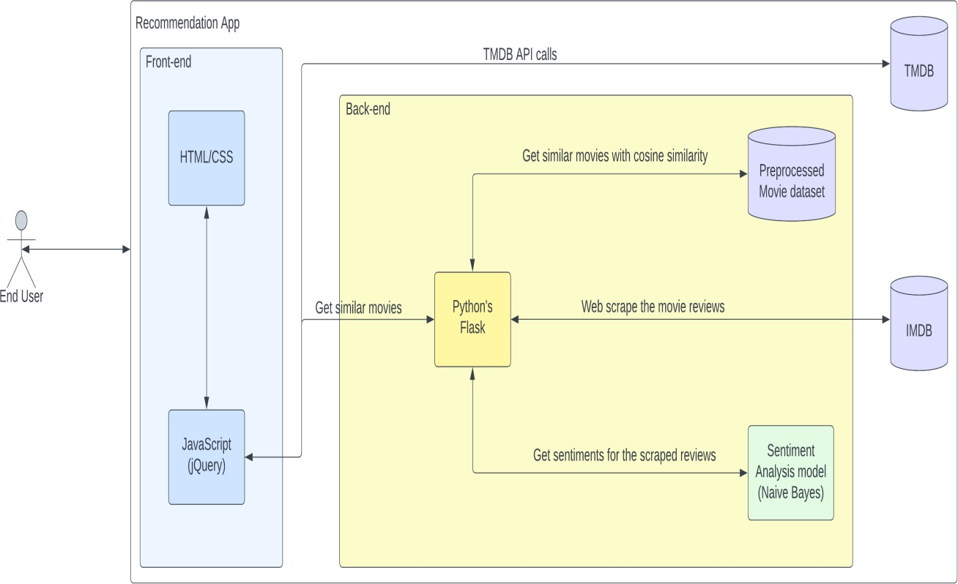
Synopsis
System Design
Architecture:
SYSTEM REQUIREMENTS SPECIFICATION
This involves both the hardware and software requirements needed for the project.
Hardware Requirements:
A PC with Windows/Linux OS
Processor with 1.7-2.4gHz speed
Minimum of 8gb RAM Software Specification:
Anaconda distribution package (PyCharm Editor)
Python libraries
HTML/CSS/JS for frontend
Flask framework

Slide 5
Synopsis
Conclusion and future Scope
Conclusion:
For the Movie Recommendation System, the Cosine Similarity algorithm has been used to
recommend the best movies that are related to the movie entered by the user based on different factors such as the genre of the movie, overview, the cast as well as the ratings given to the movie. Cosine Similarity has given fair results even after running several tests on it and has been quite accurate at recommending the movies.
Although the system is very accurate, it does have some limitations. One of which is, if the movie entered by the user isn't present in the dataset or if the user does not enter the
name of the movie in the similar manner as that of in the dataset, then the system fails to recommend movies.
Future scope:
In the proposed approach, It has considered Genres of movies but, in future we can also consider age of user as according to the age movie preferences also changes, like for example, during our childhood we like animated movies more as compared to other
movies. There is a need to work on the memory requirements of the proposed approach in the future. The proposed approach has been implemented here on different movie datasets only. It can also be implemented on the Film Affinity and Netflix datasets and the performance can be computed in the future.
References:
Mohapatra, H., Panda, S., Rath, A., Edalatpanah, S., & Kumar, R. (2020). A tutorial on powershell pipeline and its loopholes. International journal of emerging trends in engineering research, 8(4), 975-982
Kumar, R., Edalatpanah, S. A., Jha, S., & Singh, R. (2019). A Pythagorean fuzzy approach to the transportation problem. Complex & intelligent systems, 5(2), 255-263.
Dong F, Luo J, Zhu X, Wang Y, and Shen J. A Personalized Hybrid Recommendation System Oriented to E-Commerce Mass Data in the Cloud. IEEE Transactions on Systems, Man, and Cybernetics , 16(4):1020-1025, 2013.
Modi H Y and Narvekar M. Enhancement of Online Web Recommendation System using a Hybrid Clustering and Pattern Matching Approach. IEEE conference Nascent Technologies in the Engineering Field, pages 1-6, 2015.
Nalavade K and Meshram B B. Finding Frequent Itemsets using Apriori Algorihm to Detect Intrusions in Large Dataset. International Journal of Computer Applications, 2(6):68-84, 2014

